Slide 1
Three-Dimensional Perception from a Single Image
Jitendra Malik
UC Berkeley

Slide 2
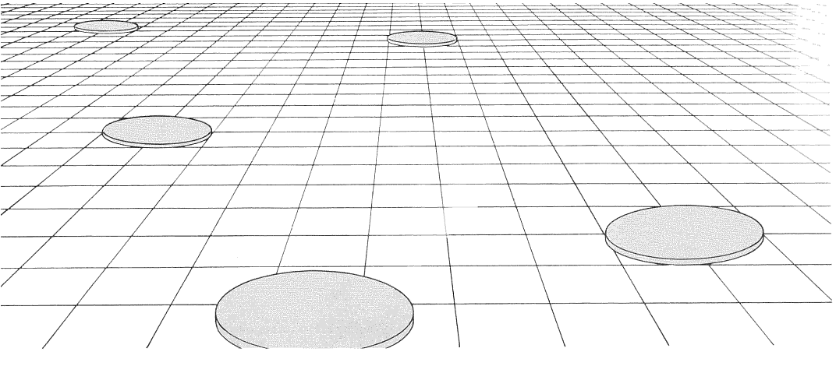
We can perceive depth in a single picture
Notes:
Here if we assume that the slabs are all of the same size and shape in the scene, then the apparent diminution of size on the image plane is a cue to changes in depth and surface slant. These kinds of grids are ubiquitous in Renaissance paintings.

Slide 3
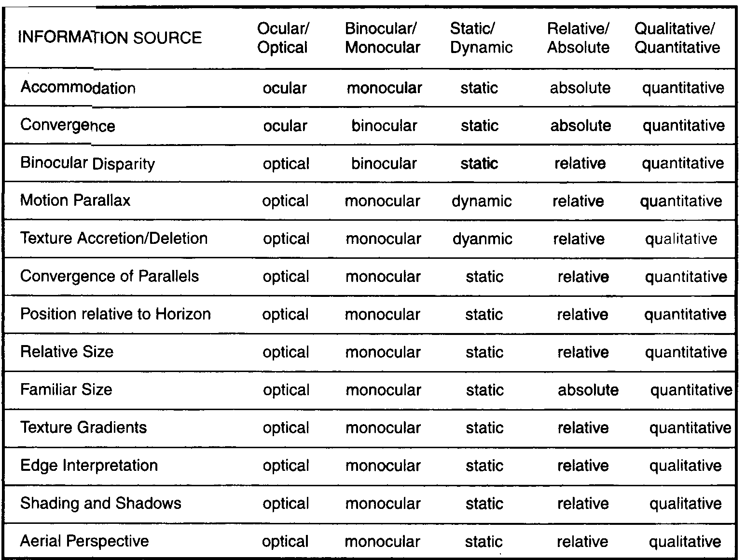
List of cues from Palmer’s Vision book

Slide 4
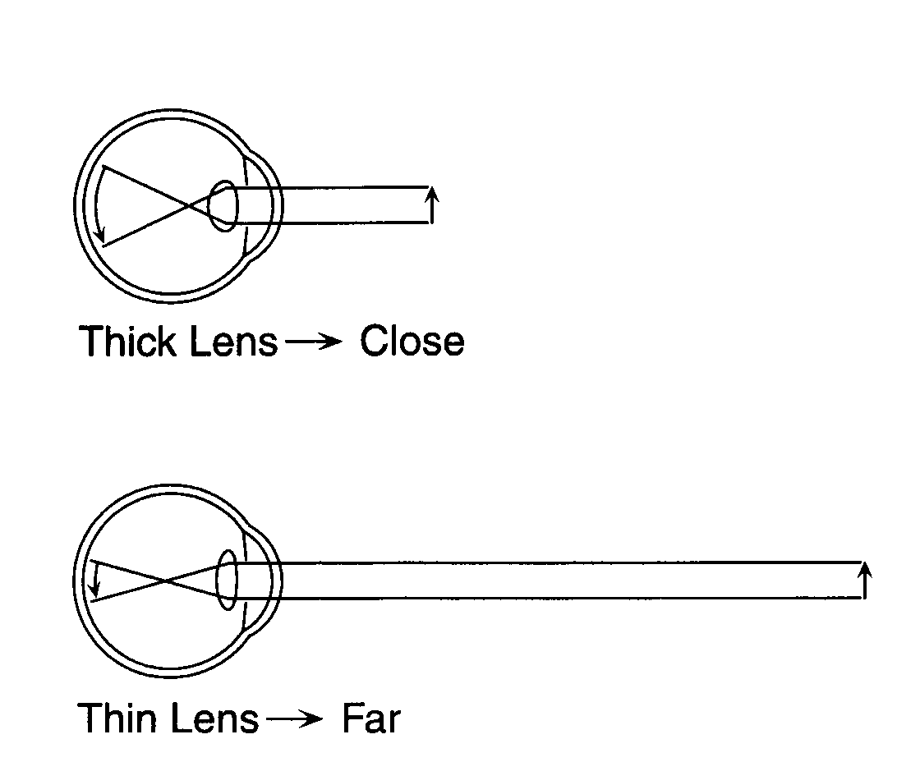
Accomodation/Depth of Focus

Slide 5
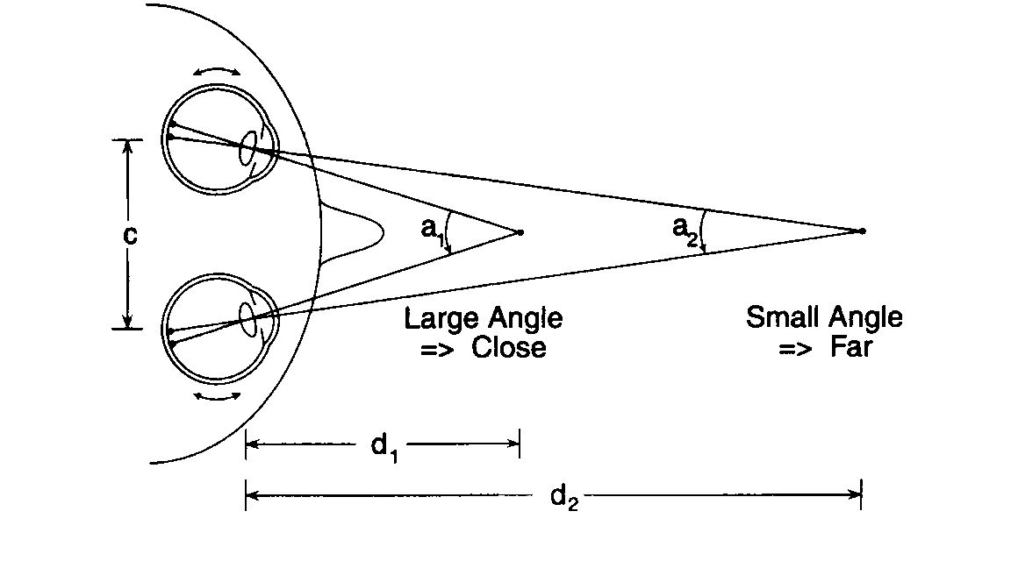
Convergence

Slide 6
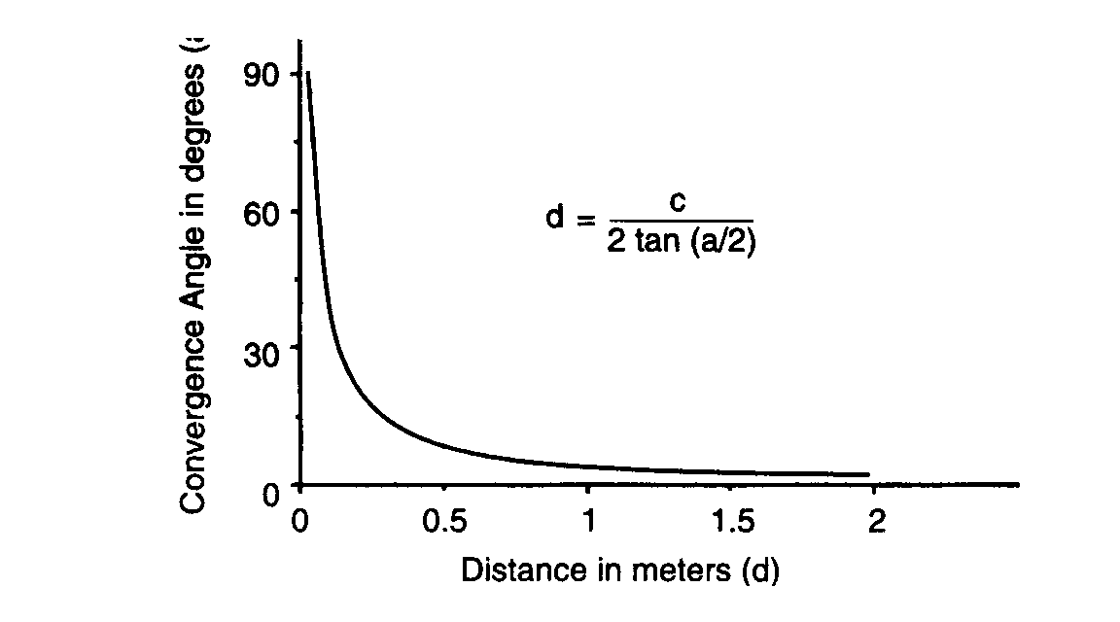
Convergence angle vs. distance

Slide 7
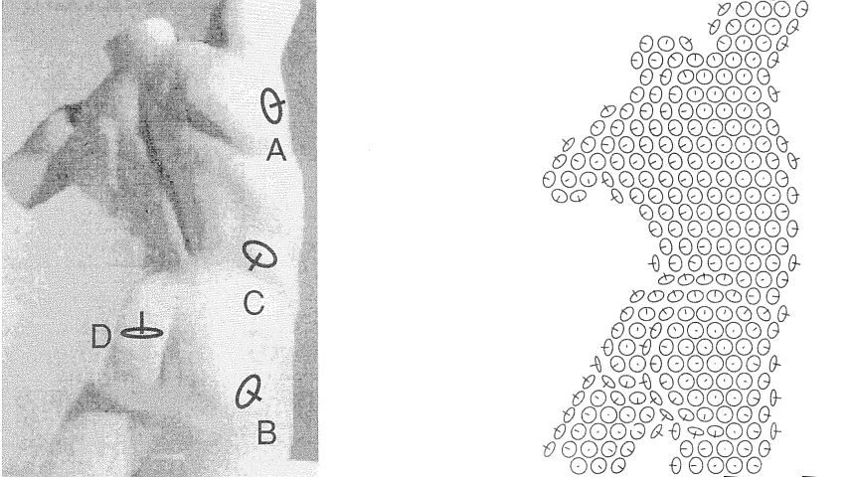
Humans perceive surface normals, not just depth, through a combination of various pictorial cues
Koenderink, van Doorn and Kappers, 1992

Slide 8
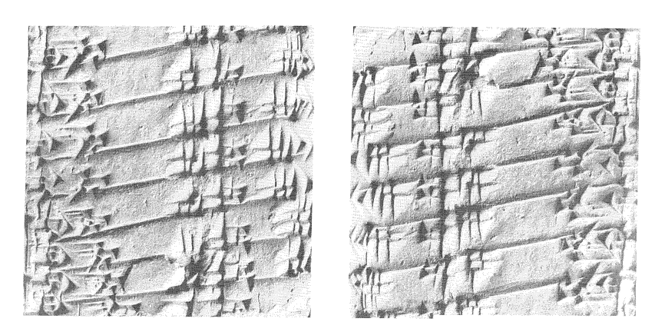
Shape from Shading

Slide 9
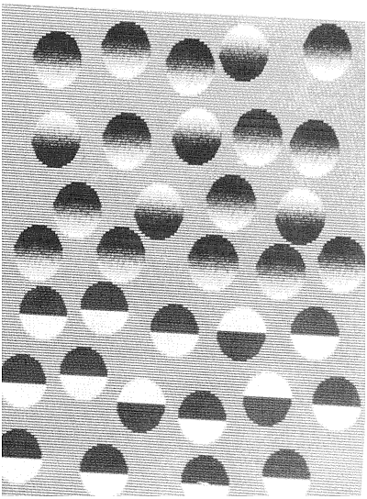
Grouping Based on Shape from Shading

Slide 10
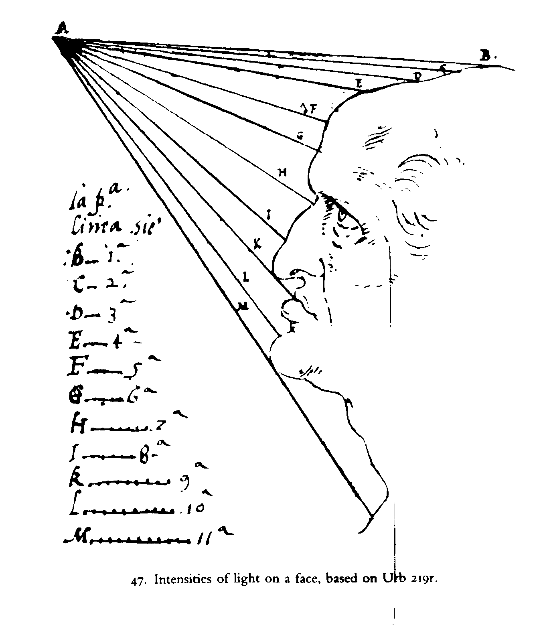
Leonardo thought of it first!

Slide 11
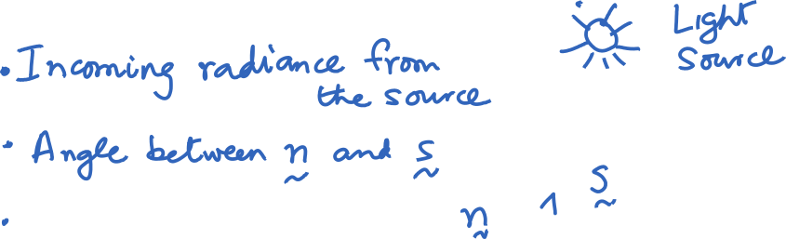






What causes the outgoing radiance at a scene patch?
Two special cases:
Specular surfaces - Outgoing radiance direction obeys angle of incidence=angle of reflection, and co-planarity of incident & reflected rays & the surface normal.
Lambertian surfaces - Outgoing radiance same in all directions

Slide 12
The Lambertian model
We often model reflectance by a combination of a Lambertian term and a specular term. If we want to be precise, we use a BRDF (Bidirectional Reflectance Distribution function) which is a 4D function corresponding to the ratio of outgoing radiance in a particular direction to the incoming irradiance in some other direction. This can be measured empirically.

Slide 13
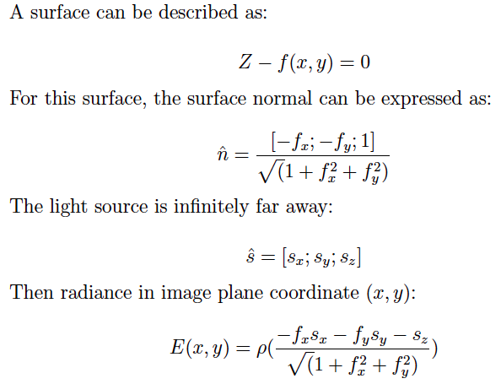
Shape from Shading

Slide 14
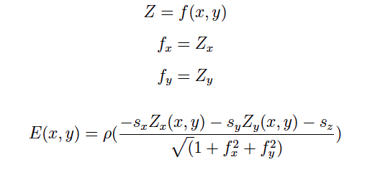
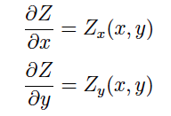
SFS results in a partial differential equation

Slide 15
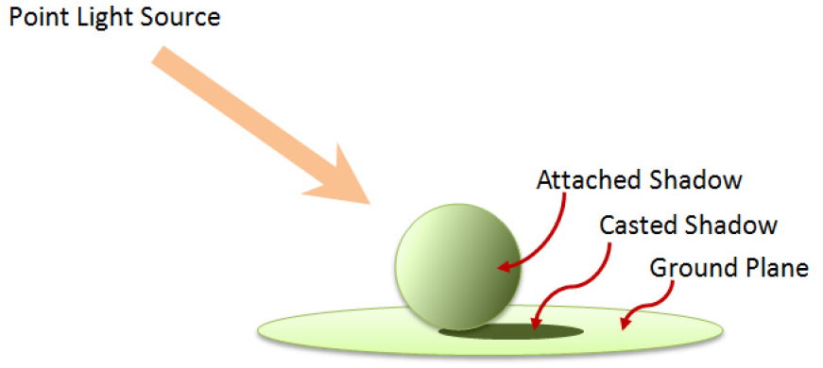
Real world scenes have additional complexity…
Objects are illuminated not just by light sources, but also by reflected light from other surfaces. In computer graphics, ray tracing and radiosity are techniques that address this issue.
Shadows

Slide 16
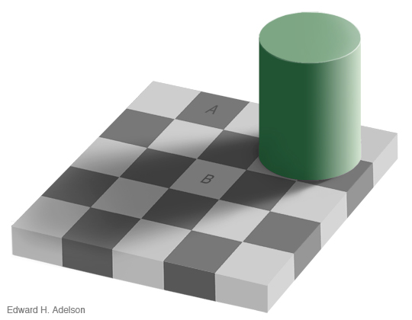
Adelson’s checkershadow

Slide 17
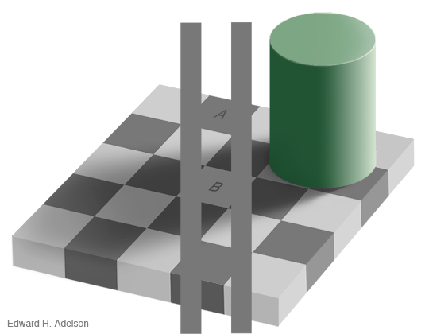
A and B have same luminance!

Slide 18

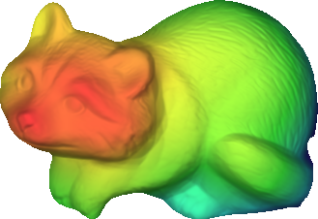
Forward Optics
Forward Optics
Far
Near
Z
shape / depth
Notes:
Let’s review image formation...

Slide 19

Forward Optics
Far
Near
Z
L
shape / depth
illumination

Slide 20

Forward Optics
Far
Near
Z
S(Z, L)
L
shape / depth
log-shading image of Z and L
illumination

Slide 21
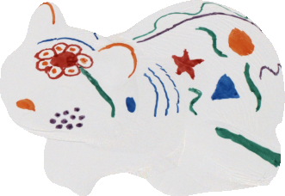
Forward Optics
Far
Near
Z
S(Z, L)
L
shape / depth
log-shading image of Z and L
illumination
R
log-reflectance

Slide 22
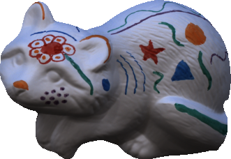
Forward Optics
Far
Near
Z
S(Z, L)
L
shape / depth
log-shading image of Z and L
illumination
R
I = R + S(Z, L)
log-reflectance
Lambertian reflectance in log-intensity
Notes:
And that’s how we get an image

Slide 23
Our problem
Far
?
?
?
Near
Z
S(Z, L)
L
shape / depth
log-shading image of Z and L
illumination
?
R
I = R + S(Z, L)
log-reflectance
Lambertian reflectance in log-intensity
Notes:
The problem we’re going to look at is inverting this process, and going from a single image to a model of shape, illumination, and albedo.

Slide 24
Past Work

Slide 25
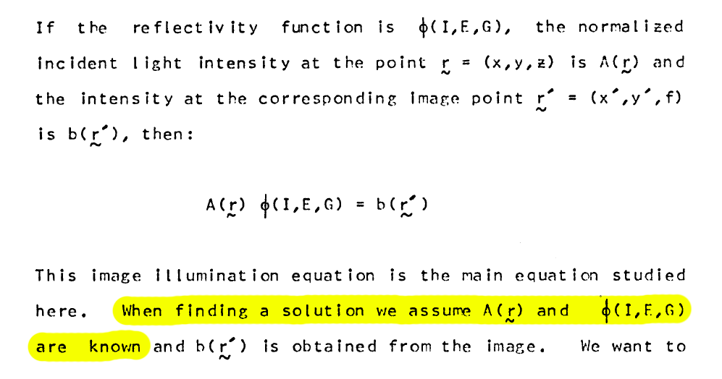
Past Work:
Shape from Shading
?
Basic Assumption: illumination and albedo are known.
Notes:
This is SFS, and even SFS is hard, though it’s not clear if it would be useful if we could even solve it.

Slide 26
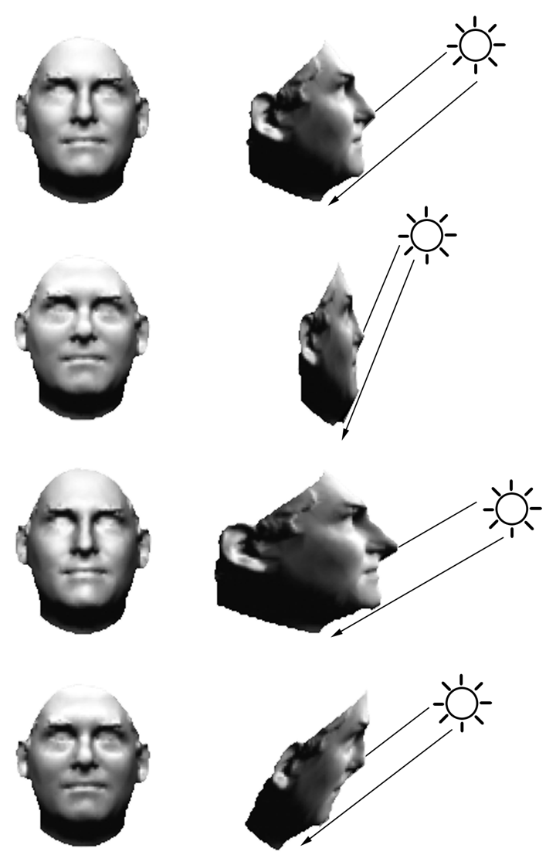
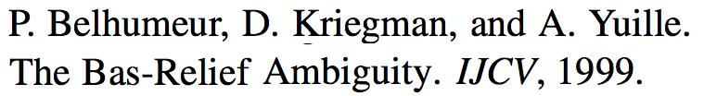
Past Work:
Shape from Shading
Notes:
Just one of the reasons SFS is hard is the Bas-Relief Ambiguity

Slide 27
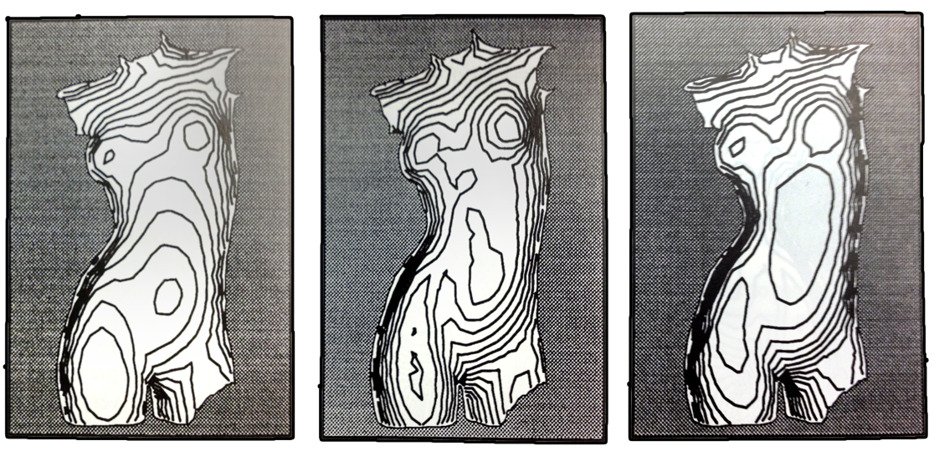
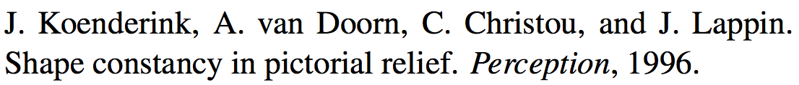
Past Work:
Shape from Shading
Notes:
Not just computers suffer from this ambiguity, so do people.

Slide 28
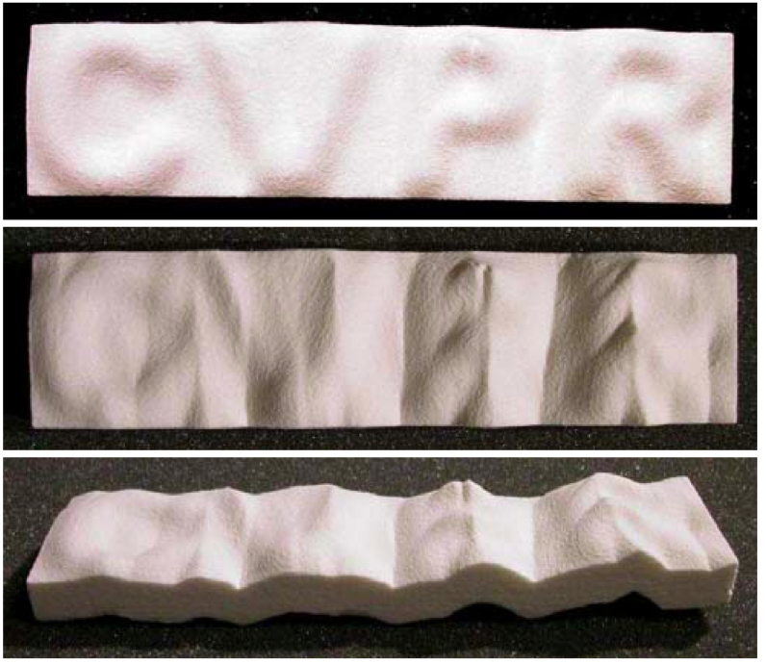
Past Work:
Shape from Shading
Ecker & Jepson, Polynomial Shape from Shading, CVPR 2010
Notes:
But the problem is even harder than the Bas-Relief ambiguity.

Slide 29
Past Work:
Shape from Shading
Ecker & Jepson, Polynomial Shape from Shading, CVPR 2010

Slide 30
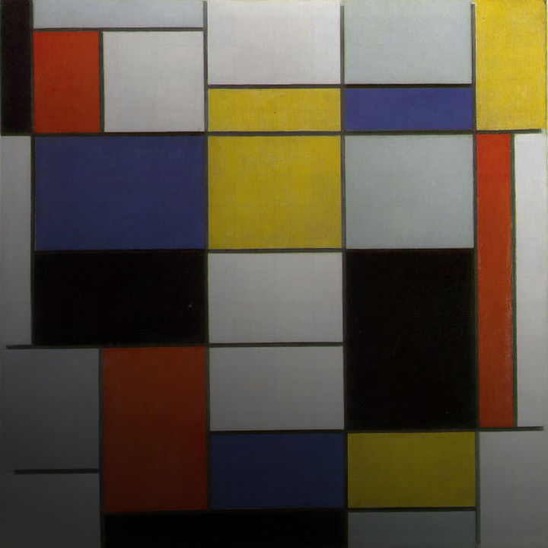
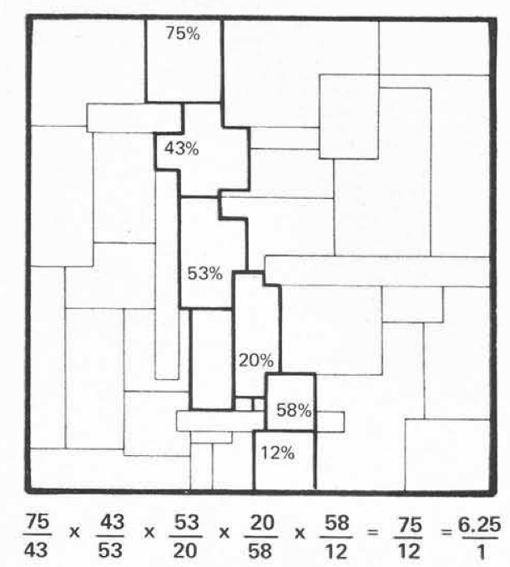
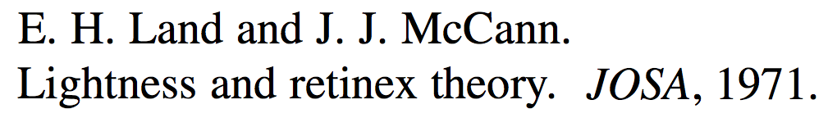
Past Work:
Lightness Recovery
?
?
Basic assumption: Shape is ignored, illumination varies slowly, therefore all edges are reflectance edges.
Piet Mondrian, Composition A. Oil on Canvas, 1920.
Notes:
We also have Retinex

Slide 31
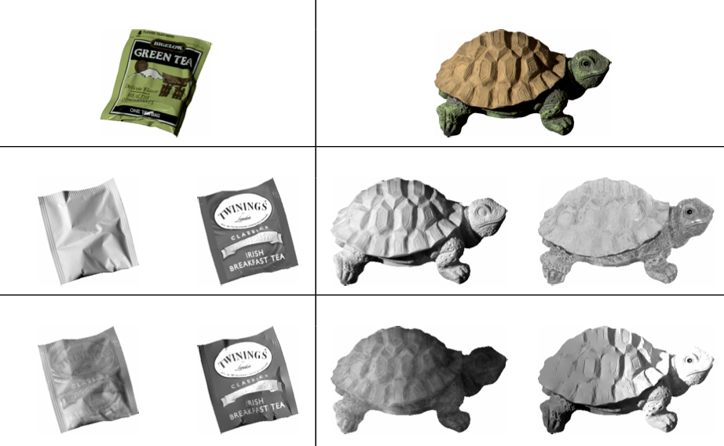
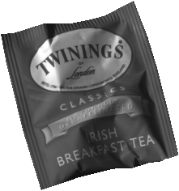
Past Work:
Lightness Recovery
Horn. Determining lightness from an image. CGIP, 1974 Grosse et el., Ground-truth dataset and baseline evaluations for intrinsic image algorithms, ICCV, 2009
Notes:
Here are input images

Slide 32
Past Work:
Lightness Recovery
Horn. Determining lightness from an image. CGIP, 1974 Grosse et el., Ground-truth dataset and baseline evaluations for intrinsic image algorithms, ICCV, 2009
Notes:
The ground-truth shading and albedo that made these images.

Slide 33
Past Work:
Lightness Recovery
Horn. Determining lightness from an image. CGIP, 1974 Grosse et el., Ground-truth dataset and baseline evaluations for intrinsic image algorithms, ICCV, 2009
Notes:
And Retinex. It doesn’t work well.

Slide 34
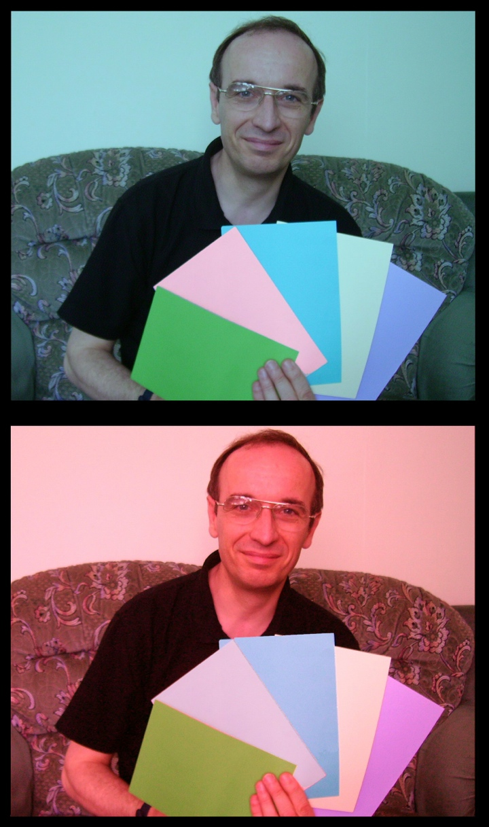
Past Work:
Color Constancy

Slide 35
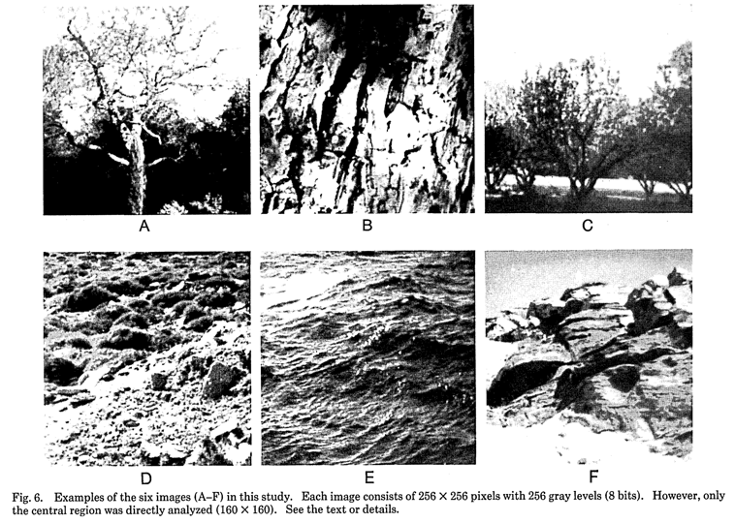
Past Work:
Natural Image Statistics
D. Field. Relations between the statistics of natural images and the response properties of cortical cells. JOSA A, 1987.

Slide 36
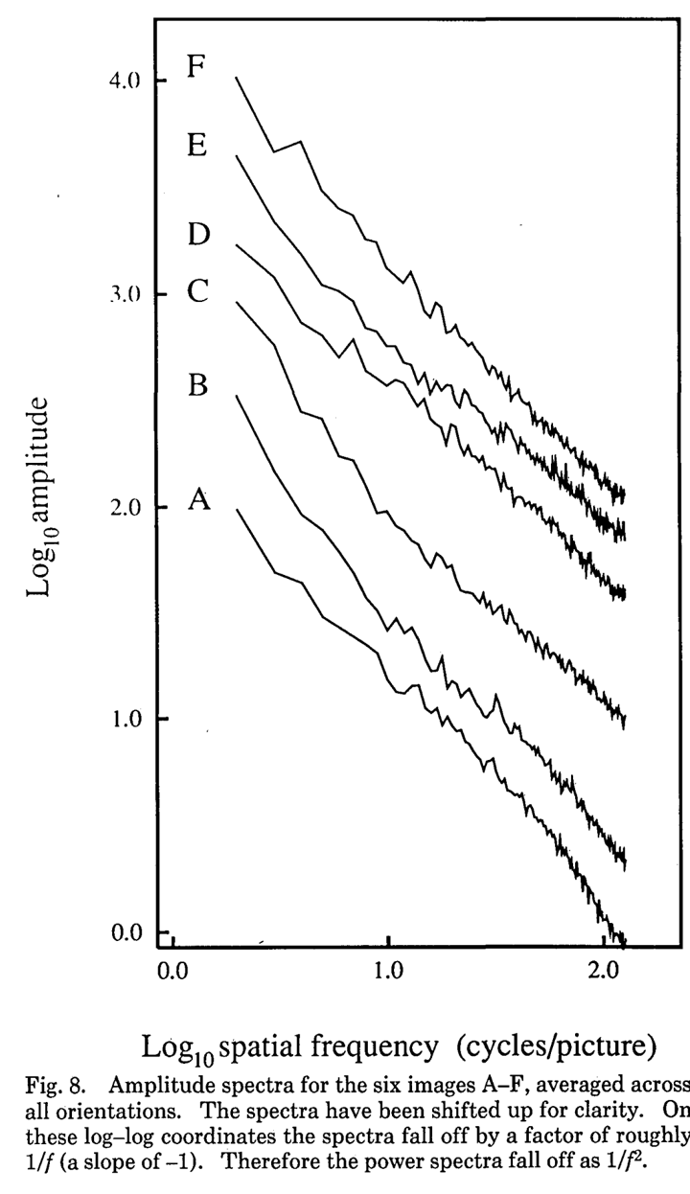
Past Work:
Natural Image Statistics
D. Field. Relations between the statistics of natural images and the response properties of cortical cells. JOSA A, 1987.

Slide 37
Past Work:
Natural Image Statistics
D. Field. Relations between the statistics of natural images and the response properties of cortical cells. JOSA A, 1987.
Statistical regularities arise in natural images (mostly) because of statistical regularities in natural environments!

Slide 38
Our Work

Slide 39
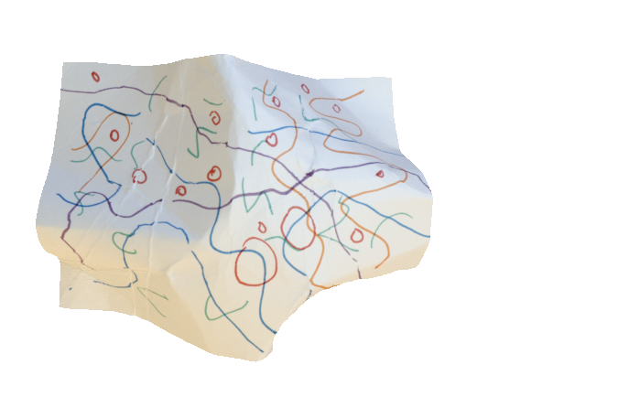
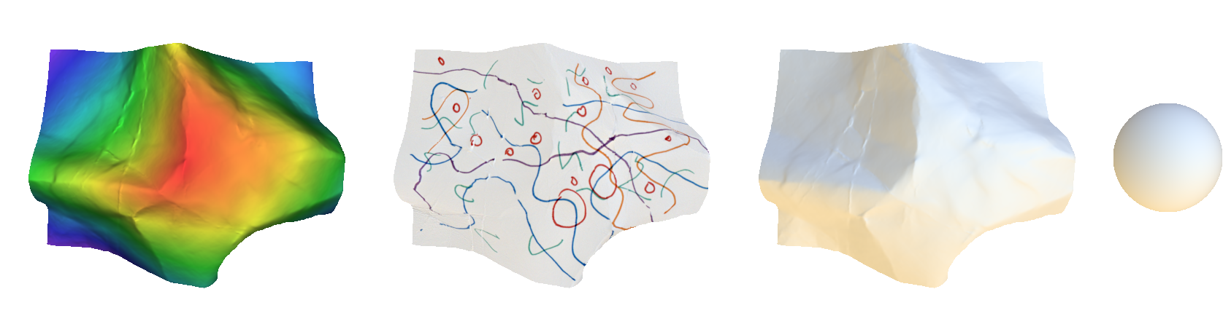
Shape, Illumination and Reflectance
from Shading
Barron & Malik, CVPR 2011, CVPR 2012, ECCV 2012
Input:
Image
Output:
Shape
Albedo
Shading
Illumination

Slide 40
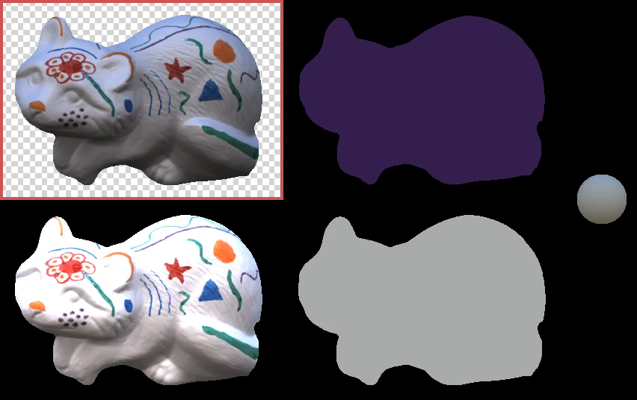
Demo!

Slide 41
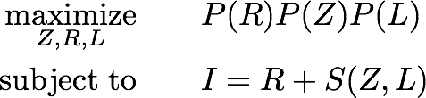
Problem Formulation
?
?
?
Z
S(Z, L)
L
?
R
I
“Search for the most likely explanation
(shape Z, log-reflectance R and illumination L)
that together exactly reconstructs log-image I”

Slide 42
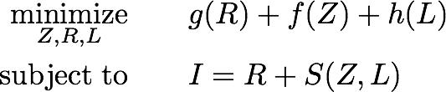
Problem Formulation
?
?
?
Z
S(Z, L)
L
?
R
I
“Search for the least costly explanation
(shape Z, log-reflectance R and illumination L)
that together exactly reconstructs log-image I”

Slide 43
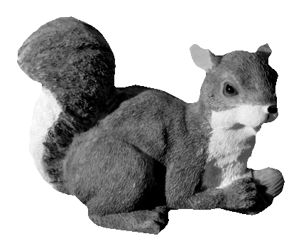
Some Explanations
Notes:
Here’s an image, let’s look at some possible explanations of this image.

Slide 44
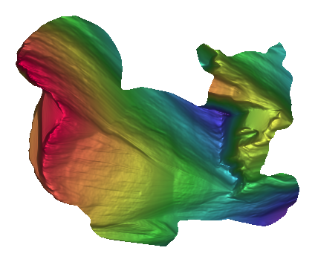

Some Explanations

Slide 45
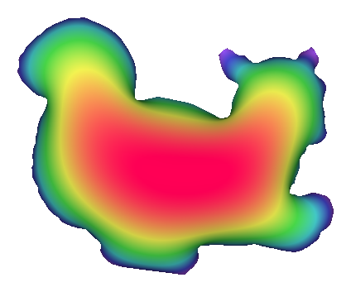
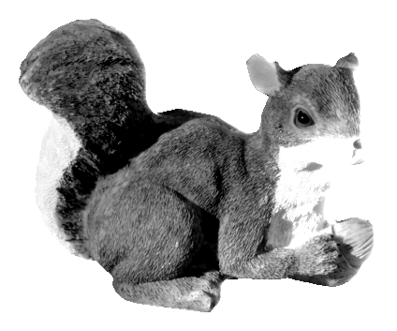
Some Explanations

Slide 46
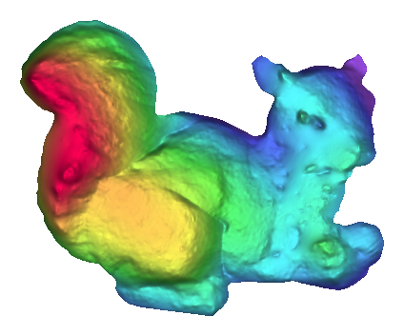
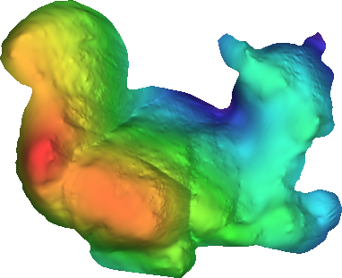
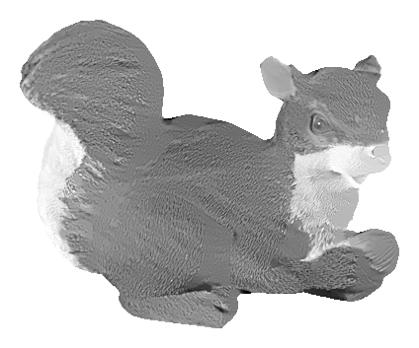
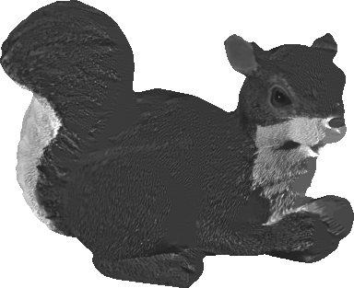
Some Explanations

Slide 47
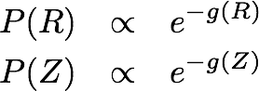
Some Explanations

Slide 48
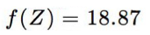
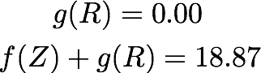
Some Explanations

Slide 49
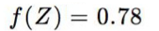

Some Explanations

Slide 50


Some Explanations

Slide 51
Problem Formulation
?
?
?
Z
S(Z, L)
L
?
R
I
“Search for the least costly explanation
(shape Z, log-reflectance R and illumination L)
that together exactly reconstructs log-image I”

Slide 52
Problem Formulation
?
?
?
Z
S(Z, L)
L
?
R
I
“Search for the least costly explanation
(shape Z, log-reflectance R and illumination L)
that together exactly reconstructs log-image I”

Slide 53
What do we know about reflectance?

Slide 54
What do we know about reflectance?
1) Piecewise smooth
(variation is small and sparse)
2) Palette is small
(distribution is low-entropy)
3) Some colors are common
(maximize likelihood under density model)

Slide 55
What do we know about reflectance?
1) Piecewise smooth
(variation is small and sparse)
2) Palette is small
(distribution is low-entropy)
3) Some colors are common
(maximize likelihood under density model)

Slide 56
What do we know about reflectance?
1) Piecewise smooth
(variation is small and sparse)
2) Palette is small
(distribution is low-entropy)
3) Some colors are common
(maximize likelihood under density model)

Slide 57

Reflectance:
Smoothness

Slide 58
Reflectance:
Smoothness

Slide 59




Reflectance:
Smoothness

Slide 60





Reflectance:
Smoothness

Slide 61




Reflectance:
Minimal Entropy

Slide 62




Reflectance:
Minimal Entropy

Slide 63





Reflectance:
Minimal Entropy

Slide 64

Reflectance:
Minimal Entropy

Slide 65
Reflectance:
Minimal Entropy

Slide 66

Reflectance:
Absolute Color

Slide 67
Reflectance:
Absolute Color

Slide 68

Reflectance:
Absolute Color

Slide 69
Problem Formulation
?
?
?
Z
S(Z, L)
L
?
R
I
“Search for the least costly explanation
(shape Z, log-reflectance R and illumination L)
that together exactly reconstructs log-image I”

Slide 70
Problem Formulation
?
?
?
Z
S(Z, L)
L
?
R
I
“Search for the least costly explanation
(shape Z, log-reflectance R and illumination L)
that together exactly reconstructs log-image I”

Slide 71
What do we know about shapes?

Slide 72

What do we know about shapes?
1) Piecewise smooth
(variation in mean curvature is small and sparse)

Slide 73
What do we know about shapes?
1) Piecewise smooth
(variation in mean curvature is small and sparse)
2) Face outward at the occluding contour
3) Tend to be fronto-parallel
(slant tends to be small)

Slide 74
What do we know about shapes?
1) Piecewise smooth
(variation in mean curvature is small and sparse)
2) Face outward at the occluding contour
3) Tend to be fronto-parallel
(slant tends to be small)

Slide 75
Shapes:
Smoothness

Slide 76

Shapes:
Smoothness
What’s a good representation of shape for imposing priors?

Slide 77


Shapes:
Smoothness
Mean Curvature of Z
(zero on planes, constant on cylinders and spheres)

Slide 78


Shapes:
Smoothness
Variation of Mean Curvature of Z
“bending”

Slide 79
Shapes:
Smoothness

Slide 80

Shapes:
Smoothness

Slide 81
Shapes:
Smoothness

Slide 82



Shapes:
Smoothness

Slide 83
Shapes:
Occluding Contours

Slide 84

Shapes:
Occluding Contours

Slide 85

Shapes:
Occluding Contours

Slide 86

Shapes:
Occluding Contours

Slide 87
Shapes:
Fronto-Parallel

Slide 88

Shapes:
Fronto-Parallel
If we observe a surface, it is more likely that it faces us (N^{z} ≈ 1) than that it is perpendicular to us (N^{z} ≈ 0)

Slide 89
Shapes:
Fronto-Parallel
Okay
Better
Bad
Bad
If we observe a surface, it is more likely that it faces us (N^{z} ≈ 1) than that it is perpendicular to us (N^{z} ≈ 0)

Slide 90
Problem Formulation
?
?
?
Z
S(Z, L)
L
?
R
I
“Search for the least costly explanation
(shape Z, log-reflectance R and illumination L)
that together exactly reconstructs log-image I”

Slide 91
Problem Formulation
?
?
?
Z
S(Z, L)
L
?
R
I
“Search for the least costly explanation
(shape Z, log-reflectance R and illumination L)
that together exactly reconstructs log-image I”

Slide 92



What do we know about light?
1) Global illumination is well modeled with spherical harmonics:

Slide 93
What do we know about light?
1) Global illumination is well modeled with spherical harmonics:
2) Spherical harmonic coefficients are well-modeled with a Gaussian

Slide 94

What do we know about light?
Natural Illuminations from our dataset

Slide 95
What do we know about light?
Natural Illuminations from our dataset
Samples from a Gaussian fit to the training set

Slide 96
Problem Formulation
?
?
?
Z
S(Z, L)
L
?
R
I
“Search for the least costly explanation
(shape Z, log-reflectance R and illumination L)
that together exactly reconstructs log-image I”

Slide 97
Problem Formulation
?
?
?
Z
S(Z, L)
L
?
R
I
“Search for the least costly explanation
(shape Z, log-reflectance R and illumination L)
that together exactly reconstructs log-image I”

Slide 98
Problem Formulation
?
?
?
Z
S(Z, L)
L
?
R
I
“Search for the least costly explanation
(shape Z, log-reflectance R and illumination L)
that together exactly reconstructs log-image I”

Slide 99

Optimization
Straightforward L-BFGS with respect to fails!

Slide 100


Optimization
Straightforward L-BFGS with respect to fails!
Instead, optimize over , a Laplacian pyramid of

Slide 101

Optimization
Straightforward L-BFGS with respect to fails!
Instead, optimize over , a Laplacian pyramid of
Psuedocode:

Slide 102

Evaluation:
Known Lighting

Slide 103
Evaluation:
Known Lighting

Slide 104
Evaluation:
Known Lighting

Slide 105
Evaluation:
Known Lighting

Slide 106

Evaluation:
Known Lighting

Slide 107

Evaluation:
Known Lighting

Slide 108

Evaluation:
Unknown Lighting

Slide 109

Evaluation:
Unknown Lighting

Slide 110

Evaluation:
Known vs Unknown

Slide 111

Evaluation:
Real World Images

Slide 112

Evaluation:
Real World Images

Slide 113

Evaluation:
Real World Images

Slide 114

Evaluation:
The Numbers

Slide 115
Evaluation:
The Numbers

Slide 116
Evaluation:
The Numbers

Slide 117
Evaluation:
The Numbers

Slide 118
Evaluation:
The Numbers

Slide 119
Color!

Slide 120

Color: The Good
Color light tells you a lot about shape

Slide 121
Color: The Good
Color light tells you a lot about shape

Slide 122

Color: The Good
Color images help distinguish between albedo and shading...
Gehler et al.
(the best-performing
intrinsic image algorithm)
Input Image

Slide 123

Color: The Bad
...but things get tricky if illumination isn’t white
(and illumination is almost never white)
Gehler et al.
(the best-performing
intrinsic image algorithm)
Input Image

Slide 124

Results
Input Image
Ground Truth
Our Model
Gehler et al

Slide 125

Results
Input Image
Ground Truth
Our Model
Gehler et al

Slide 126

Results
Input Image
Ground Truth
Gehler et al
Our Model

Slide 127


Results: Laboratory Illumination

Slide 128


Results: Natural Illumination

Slide 129

Evaluation:
Graphics!

Slide 130
Conclusions
Unification shape-from-shading, intrinsic images, and color constancy
12

Slide 131
Conclusions
Unification shape-from-shading, intrinsic images, and color constancy
Solving the unified problem > Solving any sub-problem
12

Slide 132
Conclusions
Unification shape-from-shading, intrinsic images, and color constancy
Solving the unified problem > Solving any sub-problem
Not a toy
12

Slide 133
Conclusions
Unification shape-from-shading, intrinsic images, and color constancy
Solving the unified problem > Solving any sub-problem
Not (and can never be?) metrically accurate
12

Slide 134



Closing thoughts…
“Nothing of what is visible, apart from light and color, can be perceived by pure sensation, but only by discernment, inference, and recognition, in addition to sensation.”
Alhazen
965-1040
“Vision can only be the result of some form of unconscious inferences: a matter of making assumptions and conclusions from incomplete data, based on previous experiences.”
Hermann von Helmholtz
1821-1894

Slide 135
Texture gradient cues
Notes:
Here if we assume that the slabs are all of the same size and shape in the scene, then the apparent diminution of size on the image plane is a cue to changes in depth and surface slant. These kinds of grids are ubiquitous in Renaissance paintings.

Slide 136


Slide 137


Slide 138

Projection mapping

Slide 139


Slide 140
Thanks!

